Slide 1

Data Analysis with
3. Spark Structured
Streaming

Slide 2
What is Streaming Data
Continuously generated data
Coming from many data sources simultaneously
Small in size (kB range)
Examples: IoT, stock market, recommendation based on geo-location, electricity consumption...
Data Analysis with Spark - 3. Spark Structured Streaming

Slide 3
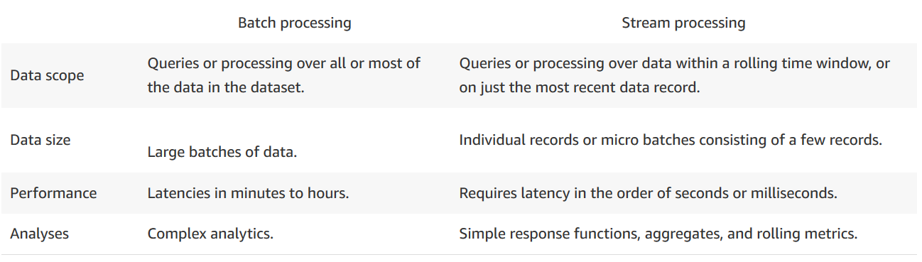
Difference between Batch and Stream Processing
Data Analysis with Spark - 3. Spark Structured Streaming

Slide 4

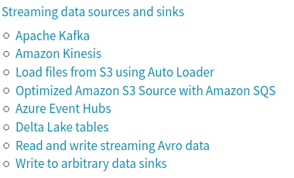

Streaming
Unbounded data sets (in opposition to finite data sets);
Unbounded data processing (in time);
Spark Structured Streaming: fault-tolerant exactly-once processing
Source
Stream Processing
Sink
(schema)
Data Analysis with Spark - 3. Spark Structured Streaming

Slide 5
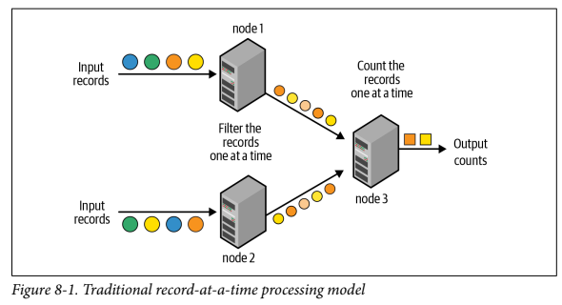
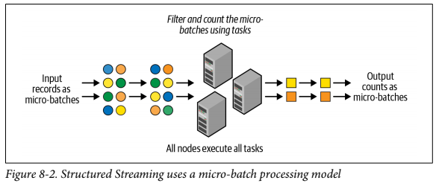
Stream processing models
Traditional vs micro-batch model
1s
redundancy
latency (ms)
redundancy
latency (100 ms: exactly-once)
Data Analysis with Spark - 3. Spark Structured Streaming

Slide 6
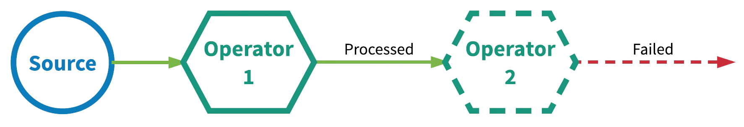
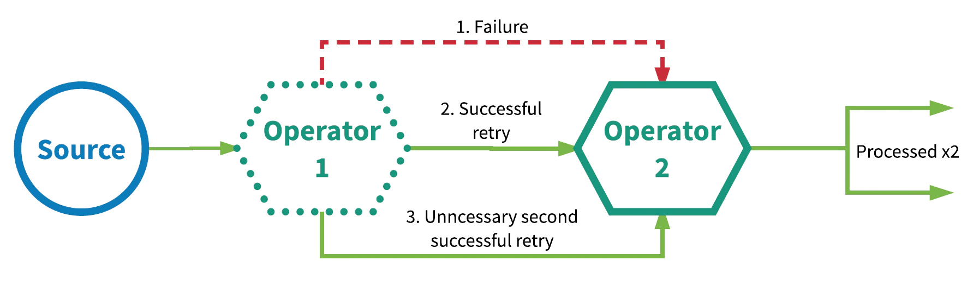
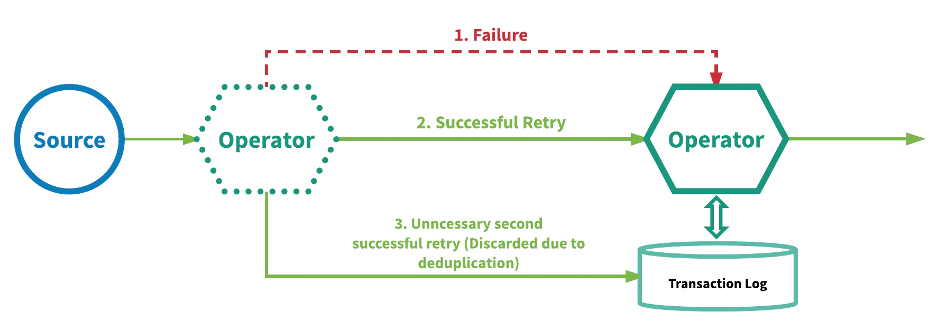
Different processing semantics
At-most-once
At-least-once
Exactly-once
Data Analysis with Spark - 3. Spark Structured Streaming

Slide 7
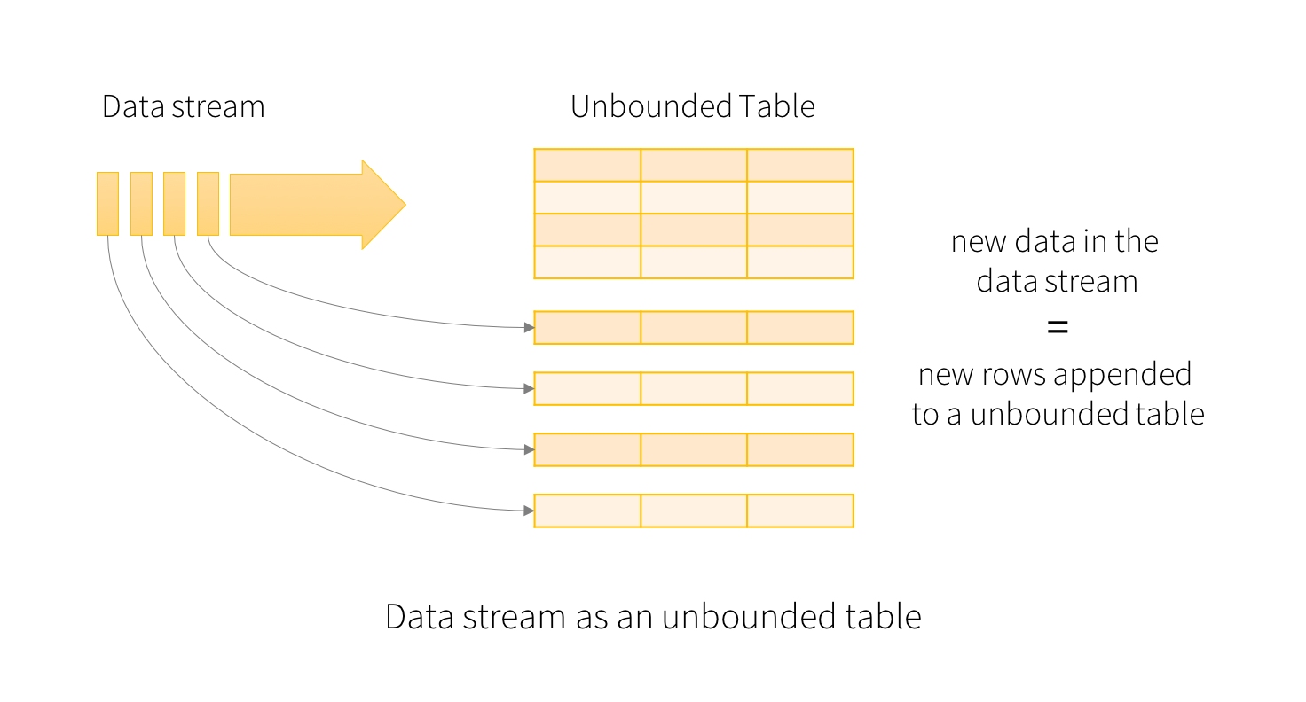
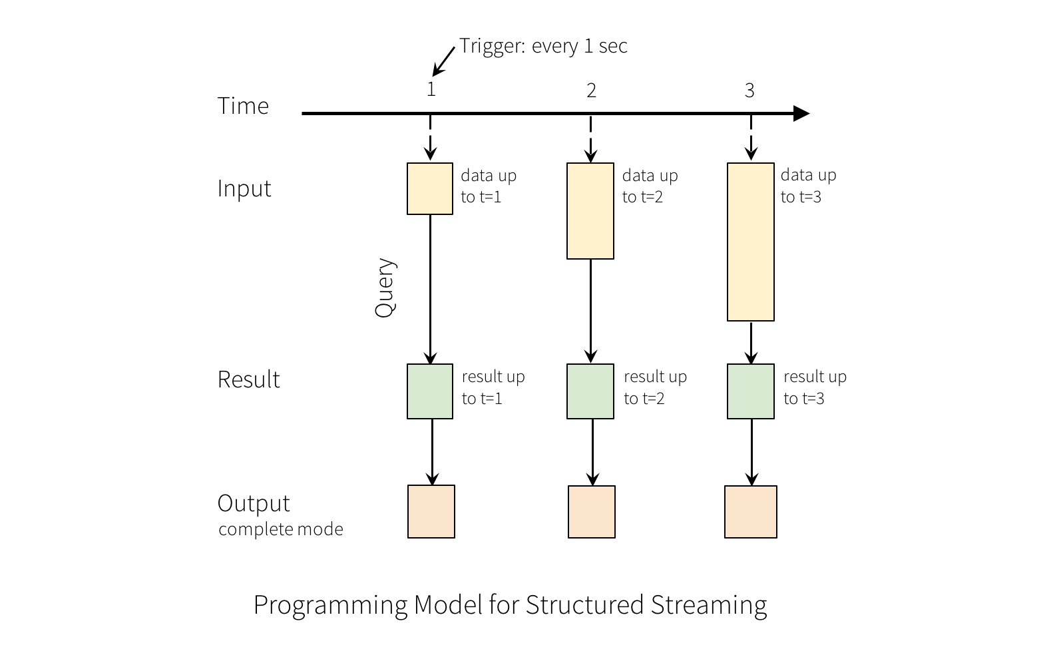
Programming model
Streaming computation as standard batch-like query
Data Analysis with Spark - 3. Spark Structured Streaming

Slide 8
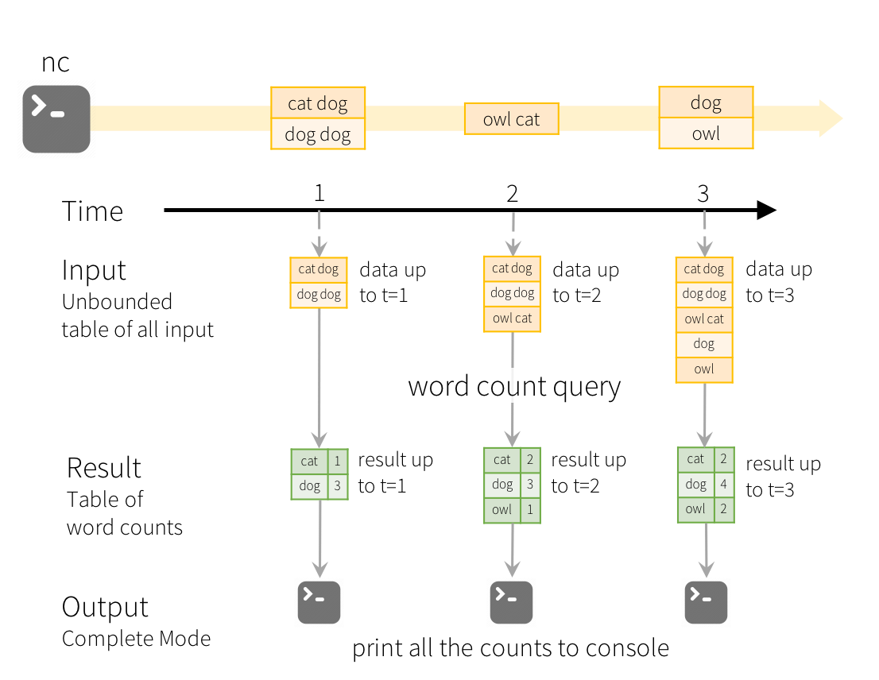
Programming model: example
Word count
Output modes:
complete - writes all the rows of a Result Table
append - writes "new" rows only
update - writes only the rows that were updated
Data Analysis with Spark - 3. Spark Structured Streaming

Slide 9
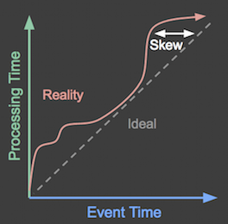
Event-time vs Processing time
event time - when the data was generated
processing time - when Spark received the data
Data Analysis with Spark - 3. Spark Structured Streaming

Slide 10
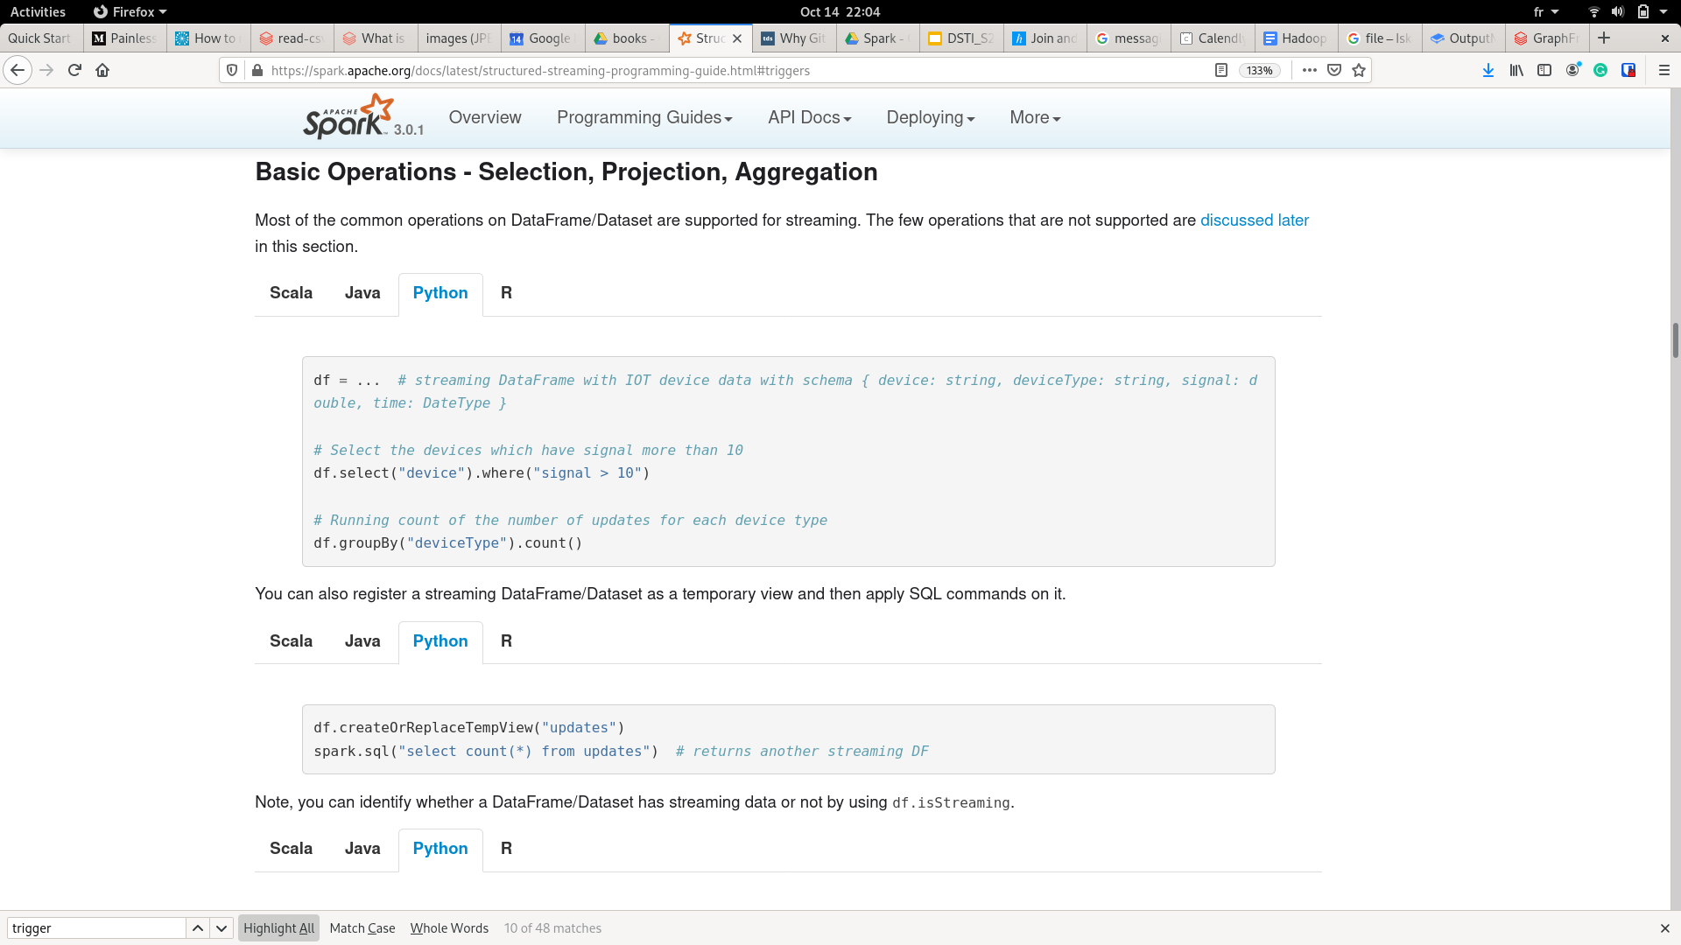
Operations on streaming DataFrames
The syntax is very similar than what we saw with static DFs
SQL-like and RDD-like operations
several operations are not supported: distinct, take(n), limit, chained aggregations, some types of joins...
Data Analysis with Spark - 3. Spark Structured Streaming

Slide 11
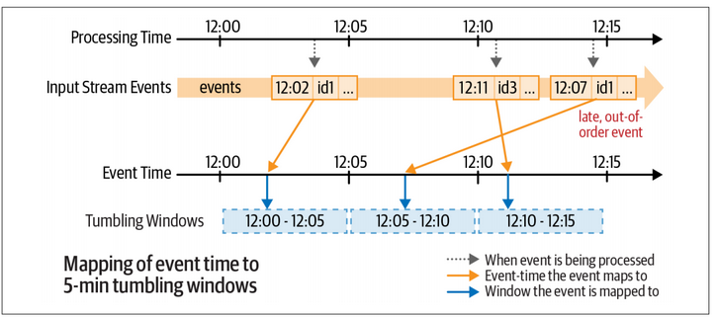
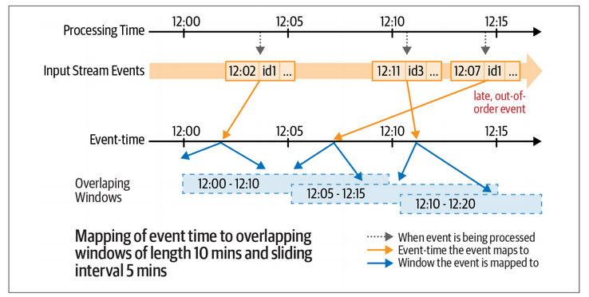
Windows: tumbling, overlapping
Each event belongs to one or more windows
Data Analysis with Spark - 3. Spark Structured Streaming

Slide 12
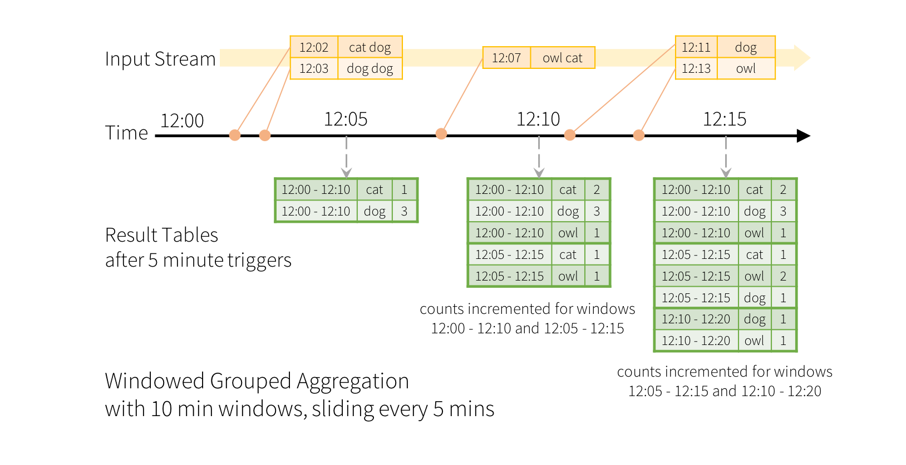
Aggregations over a sliding event-time window
Data Analysis with Spark - 3. Spark Structured Streaming

Slide 13
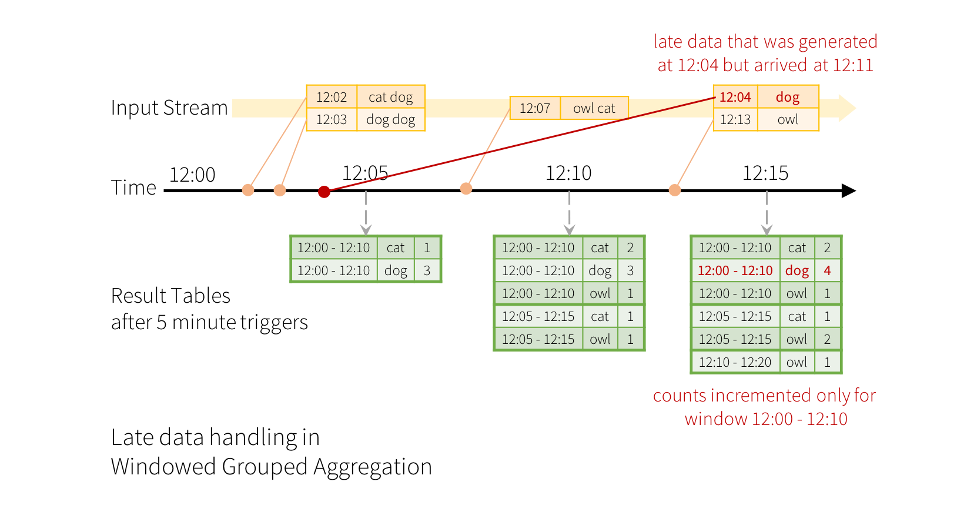
Handling late data
How long will we wait?
Data Analysis with Spark - 3. Spark Structured Streaming

Slide 14
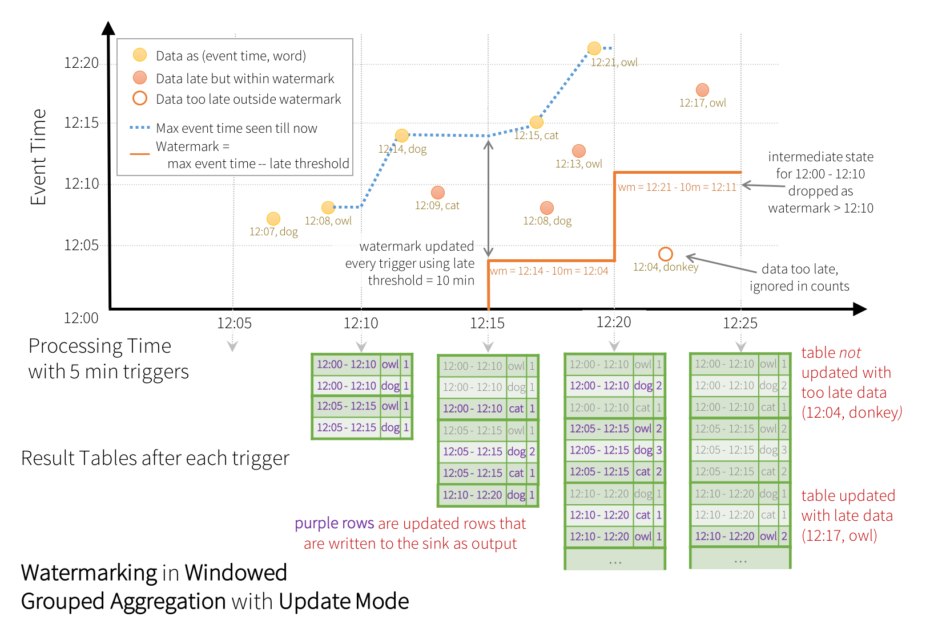
Watermarking
Data Analysis with Spark - 3. Spark Structured Streaming

Slide 15
Vocabulary
Event-time - a time when the event happens
Processing time - a time when we receive the data of the event
Trigger - how often we will collect the data
Window - for how long will we collect the data
Watermark - when the late data is discarded (how late is too late)
Data Analysis with Spark - 3. Spark Structured Streaming

